Slide 1

Elo World Team: Jon, Ben, Eleanora & Shrawantee

Slide 2
Elo Merchant Category Recommendation
Elo, one of the largest payment brands in Brazil, has built partnerships with merchants in order to offer promotions or discounts to cardholders.
For these promotions to work for either the consumer or the merchant, Elo has built machine learning models to understand the most important aspects and preferences in their customers’ lifecycle, from food to shopping.
But so far none of them is specifically tailored for an individual or profile.
We attempt to develop algorithms to identify and serve the most relevant opportunities to individuals, by uncovering signal in customer loyalty.

Slide 3
What are we predicting?
A loyalty score (target) for each customer (card_id) represented in test.csv and sample_submission.csv.
Number of Variables = 147
Few variable names and description
List of anonymized variables

Slide 4
Flow of the presentation
Description of the data: Tableau
Pipelining the data (Python)
Principle Component Analysis (Python)
Algorithms (Python)
Multivariate Linear Regression
Lasso
Random Forest
Neural Network
LGBM (Light Gradient Boosting Machine)
Logistic Regression
Conclusions

Slide 5
Descriptive Statistics : Tableau

Slide 6
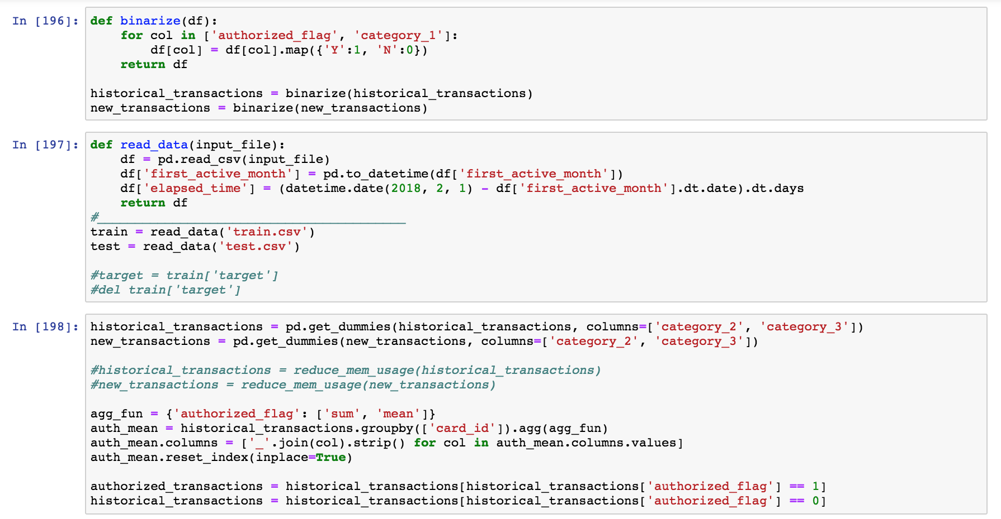
Pipelining
Convert no and yes to 0 and 1
Convert “first_active_month” to an integer value
One-hot-encoding of categorical data

Slide 7
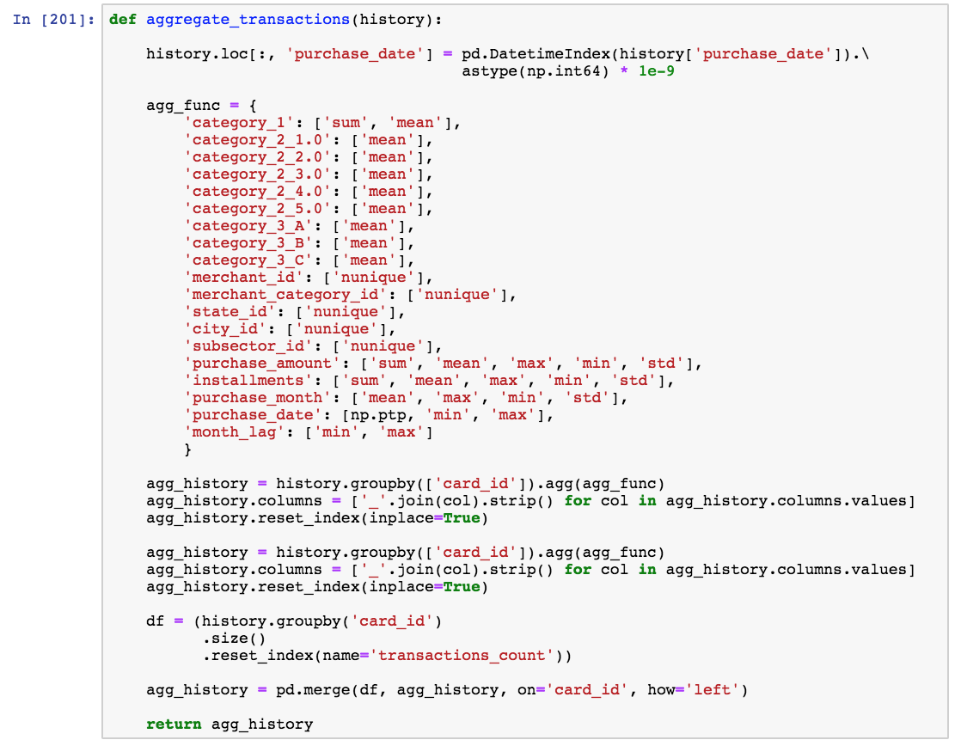
Pipelining (continued)
Grouping transaction data by card ID to
extract information on each card user:
- Average, max, median, std for continuous variables
- For categorical variables the averages provide frequency related information

Slide 8

Neural Network
Binned target results based on “Loyal” and “Disloyal” scores
Scaled data to range between 1 and 0
Did a principal component analysis to determine most variance in the data and to make network easier to run.
Ran Neural Network, achieved a accuracy of 0.
Conclusion:
This is a complex dataset that may require multiple kinds of models working in synchrony to make accurate predictions.

Slide 9
Multivariate Linear Regression

Slide 10
Lasso

Slide 11
Random Forest

Slide 12
Neural Networks

Slide 13
LGBM (Light Gradient Boosting Machine)

Slide 14
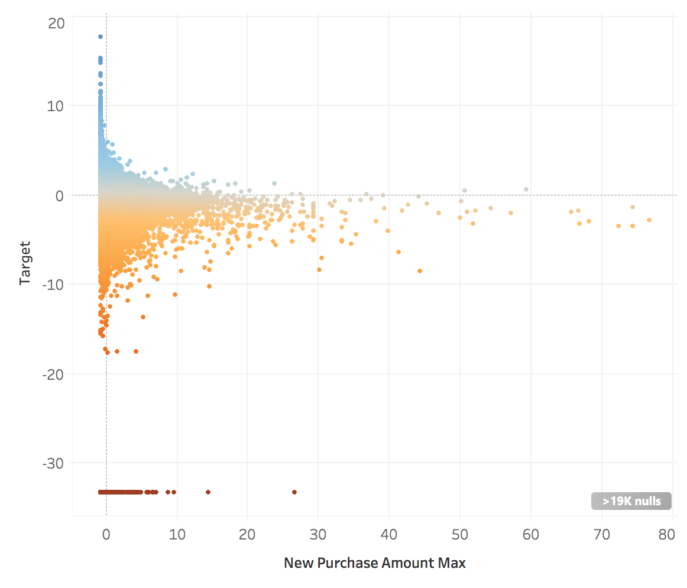
Logistic Regression

Slide 15
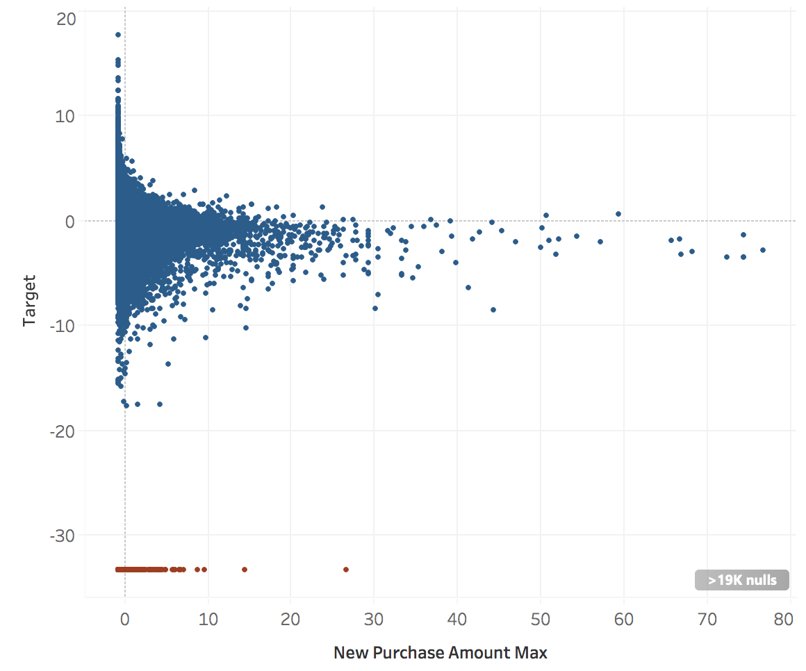
Logistic Regression
Normal loyalty
Extremely disloyal

Slide 16
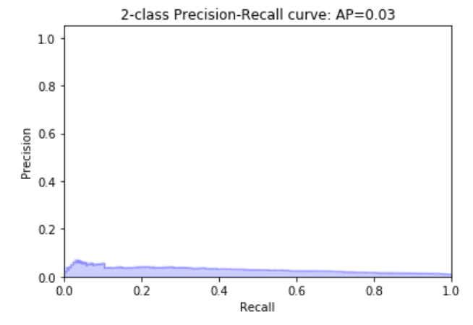
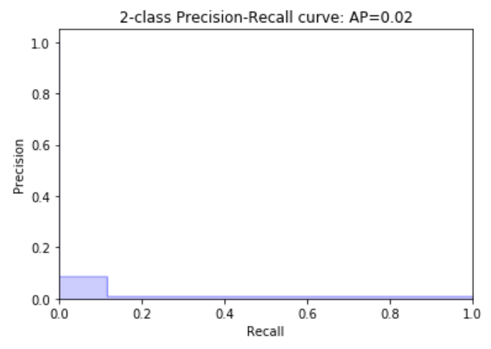
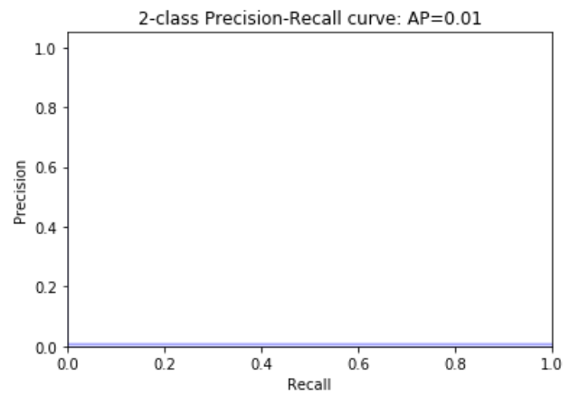
Logistic Regression
Decision Tree
Random Forest

Slide 17
Conclusion

Slide 18


